Slide 1
Gravitational Wave Data Analysis
Zachary Cohen, Dechong Wang, John Wright

Slide 2
Motivation
Understanding gravitational waves
Binary black hole mergers give off energy as gravitational waves
We can analyze these waves (using LIGO) to find properties of these objects

Slide 3
Methods
Data source: LIGO, GW190521_074359
High and low frequencies filtered out

Slide 4
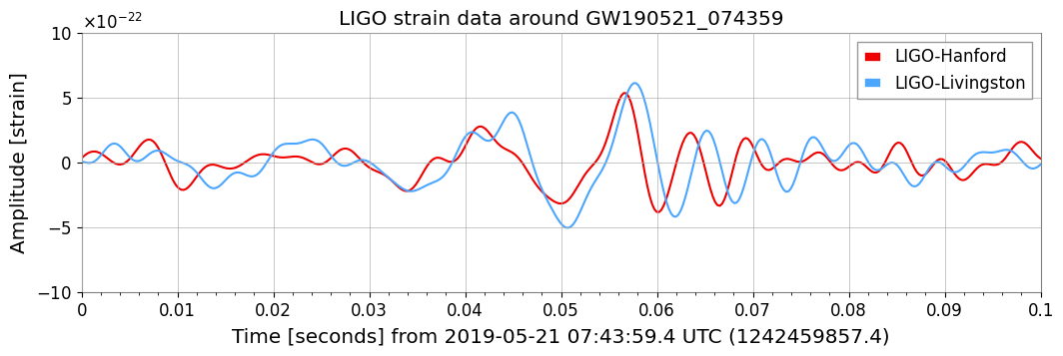
Methods - Data

Slide 5
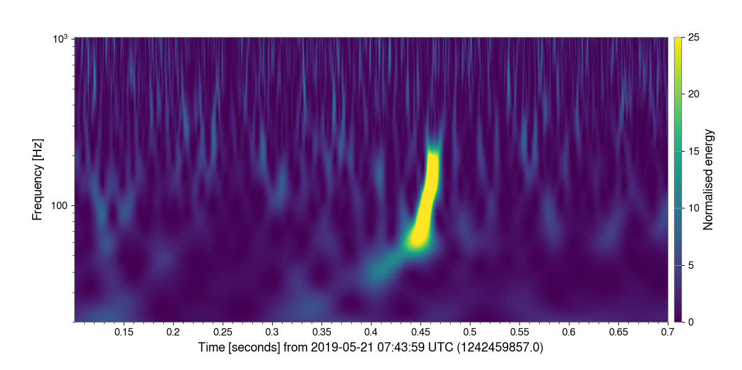
Methods - Data

Slide 6


Estimating Masses and Distance
We use the equation
From this we can derive
Here delta_t is the period of the wave and h is the amplitude

Slide 7
Results
With delta = 1.4e-2 s and h = 5.4e-22 m, approximated from the data, we get the estimates
M approx 59 solar masses
D approx 1.6e10 lightyears

Slide 8
Conclusion
This study analyzed gravitational wave data from the GW190521_074359 event detected by LIGO to explore the energy and properties of binary black hole mergers. By filtering noise, we estimated a mass of approximately 59 solar masses and a distance of around 1.6 x 10¹⁰ light-years. Our findings confirm the effectiveness of gravitational wave data in studying distant astrophysical phenomena and highlight its potential to reveal insights into the universe’s structure and black hole formation.

Slide 9
AI Statement
AI tools were not used in the creation of this presentation

Slide 10
Contribution Statement
Individual Contributions:
Zachary Cohen wrote the “Motivation” and “Contribution Statement” slides
John Wright created the “Methods”, “Estimating Masses and Distance”, and “Results” slides
Dechong Wang wrote the “Conclusion” and “AI Statement” slides

